Slide 1
A2.aa
Refresh of Week 1
Sabah Ul-Hasan

Slide 2

But first!

Slide 3
Brief Recap of Week 1 -- Congratulations 🎉

Slide 4
Brief Recap of Week 1
Participation: 2.5 pts per class for Letter and Pass/Fail Post a Question or Answer prior 8 AM PST of the next class

Slide 5
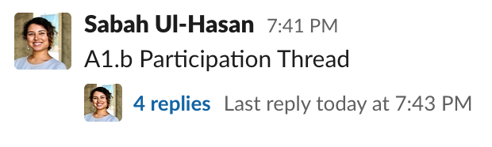
Brief Recap of Week 1
Participation: 2.5 pts per class for Letter and Pass/Fail Post a Question or Answer prior 8 AM PST of the next class

Slide 6
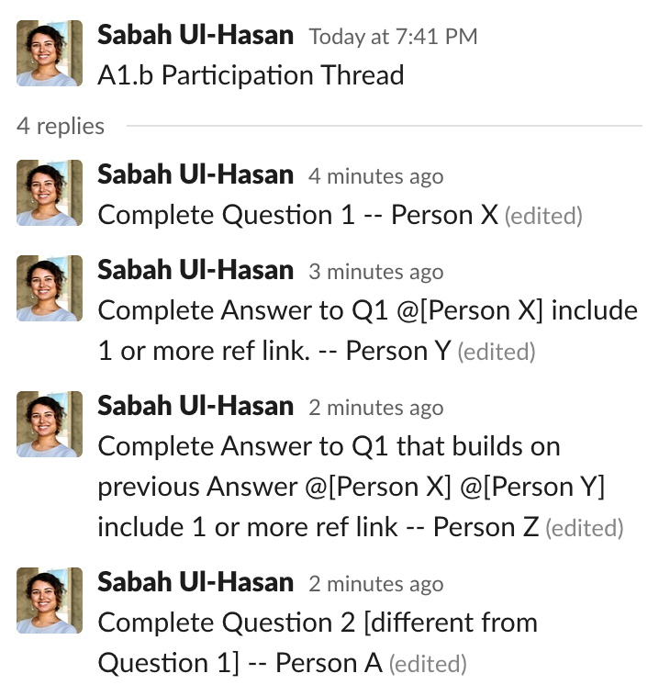
Brief Recap of Week 1

Slide 7

If we miss your question, ask us again [and again]! It’s not personal.

Slide 8
Should I change my Grading option? Should I drop the class??

Slide 9

Should I change my Grading option? Should I drop the class??
Everyone in this class is fully capable of excelling.

Slide 10
Resources
Jupyter Notebook
Beginner’s Guide
Keyboard shortcuts
Bash Tutorials
Tutorial 1 from Software Carpentry
Tutorial 2 from MIT
Scripting cheatsheet
Zoom study group (self-organized) for any time Meeting ID: 944 7012 5565 Passcode: AbcbStudy

Slide 11
HW 1
Key,
and troubleshooting

Slide 12
What’s a Code Review, and Why Do One?
How we approach the problem (logic)?
Why doesn’t the code work (debugging)?
Validating through checks/tests/assertions
Identifying new ways to approach code / making it more concise (optimizing/efficiency)

Slide 13

Peer Review, but with Code
https://smartbear.com/learn/code-review/what-is-code-review/
https://smartbear.com/learn/code-review/best-practices-for-peer-code-review/

Slide 14
Code Review
[ ] Open HW 2, complete A2.aa tasks in groups of 4
[ ] What’s the advantage of this > just sharing the key?
[ ] Major take-homes you’ve learned from the past week

Slide 15
Zoom Poll
The Code Review was
Very helpful.
Helpful, but would like to be paired with others of same learning level. I’m indifferent to it.
Not helpful, I’m more confused.
Notes:
Want to know if you encounter unwelcoming behavior outside or inside classroom

Slide 16
A2.ab
Open Q&A on Bash

Slide 17

One more thing
What’s awk ?

Slide 18
One more thing
awk 'pattern {action}' input-file
What’s awk ?
Command line 2.0 (for text processing): Makes it easier to redirect and pipe, aka save more time!
https://www.howtogeek.com/562941/how-to-use-the-awk-command-on-linux/
https://thegeeksalive.com/awk-command-with-examples/

Slide 19
Why do we care about any of this?

Slide 20
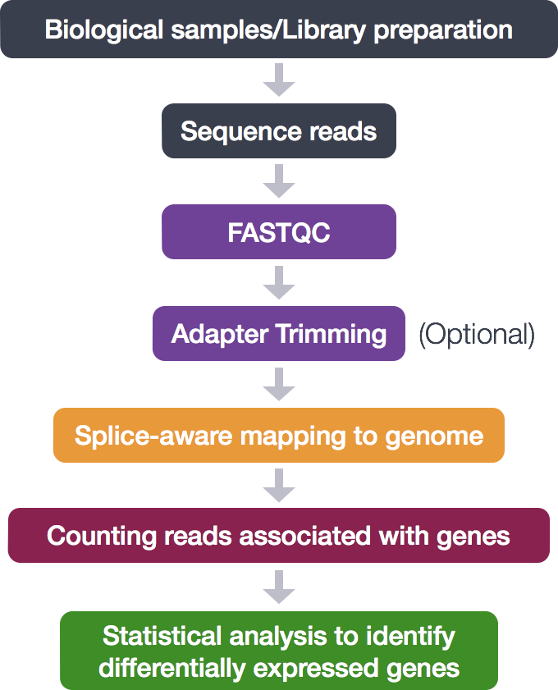
Why do we care about any of this?
}
Bash
https://hbctraining.github.io/Intro-to-rnaseq-hpc-O2/lessons/07_automating_workflow.html

Slide 21
Why do we care about any of this?
}
Bash
R
https://hbctraining.github.io/Intro-to-rnaseq-hpc-O2/lessons/07_automating_workflow.html

Slide 22
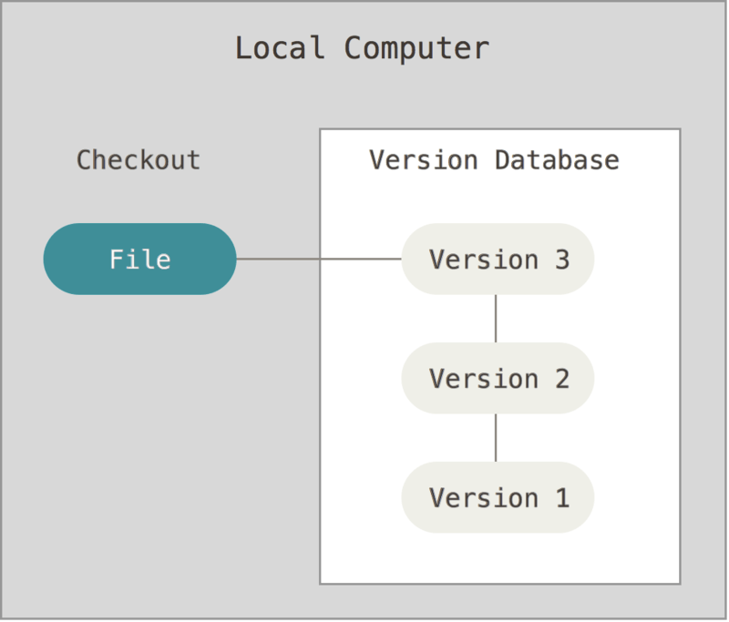
Why do we care about any of this? + Git
}
Bash
R
https://git-scm.com/book/en/v2/Getting-Started-About-Version-Control
https://hbctraining.github.io/Intro-to-rnaseq-hpc-O2/lessons/07_automating_workflow.html

Slide 23
Why do we care about any of this? + Git
}
Bash
R
https://git-scm.com/book/en/v2/Getting-Started-About-Version-Control
Github
https://hbctraining.github.io/Intro-to-rnaseq-hpc-O2/lessons/07_automating_workflow.html

Slide 24
awkward,... or easy?
[ ] Complete A2.ab tasks as a think-pair-share

Slide 25
Zoom Poll
My current view on understanding Bash script is
Better than before Week 1.
Much better than before Week 1.
The same as before joining this class.
One day at a time.
Notes:
Want to know if you encounter unwelcoming behavior outside or inside classroom

